Slide 1
Discovering Ancient Villages in Turkey
Machine Learning with Tensorflow SoSe2020

Slide 2
Team Members
Johanna Killing Msc. Environmental Geography and Management
Ali Saad Bsc. Geography
Patrick Szraga Bsc. Business Administration

Slide 3
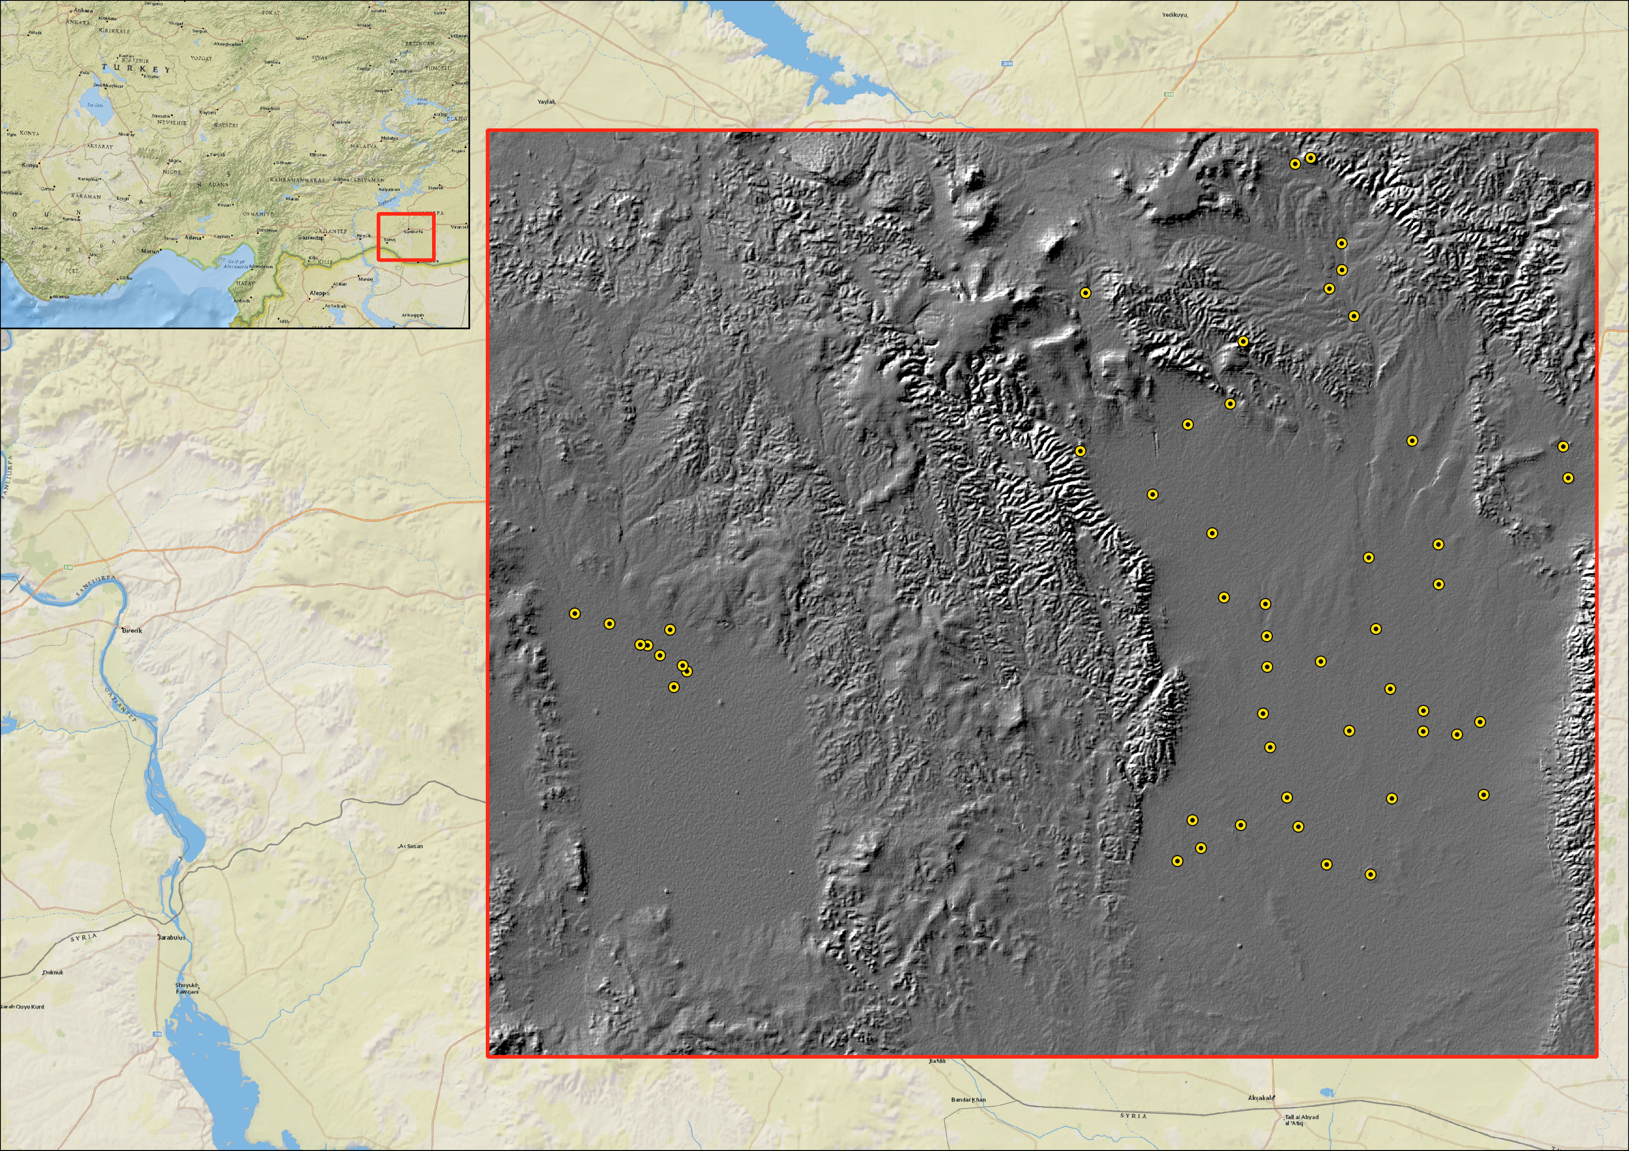
Dataset Descriptives
Shapefile containing 52 Points
Preprocessed Hillshade GeoTIFF

Slide 4
Goal Estimation
Deeper understanding for Neural Networks
Reliable model for automated Tell Prediction
Comprehensible code if a seed is used

Slide 5
Technical Environment
PyCharm
Python 2.7
Tensorflow 2.0
Multiple packages

Slide 6
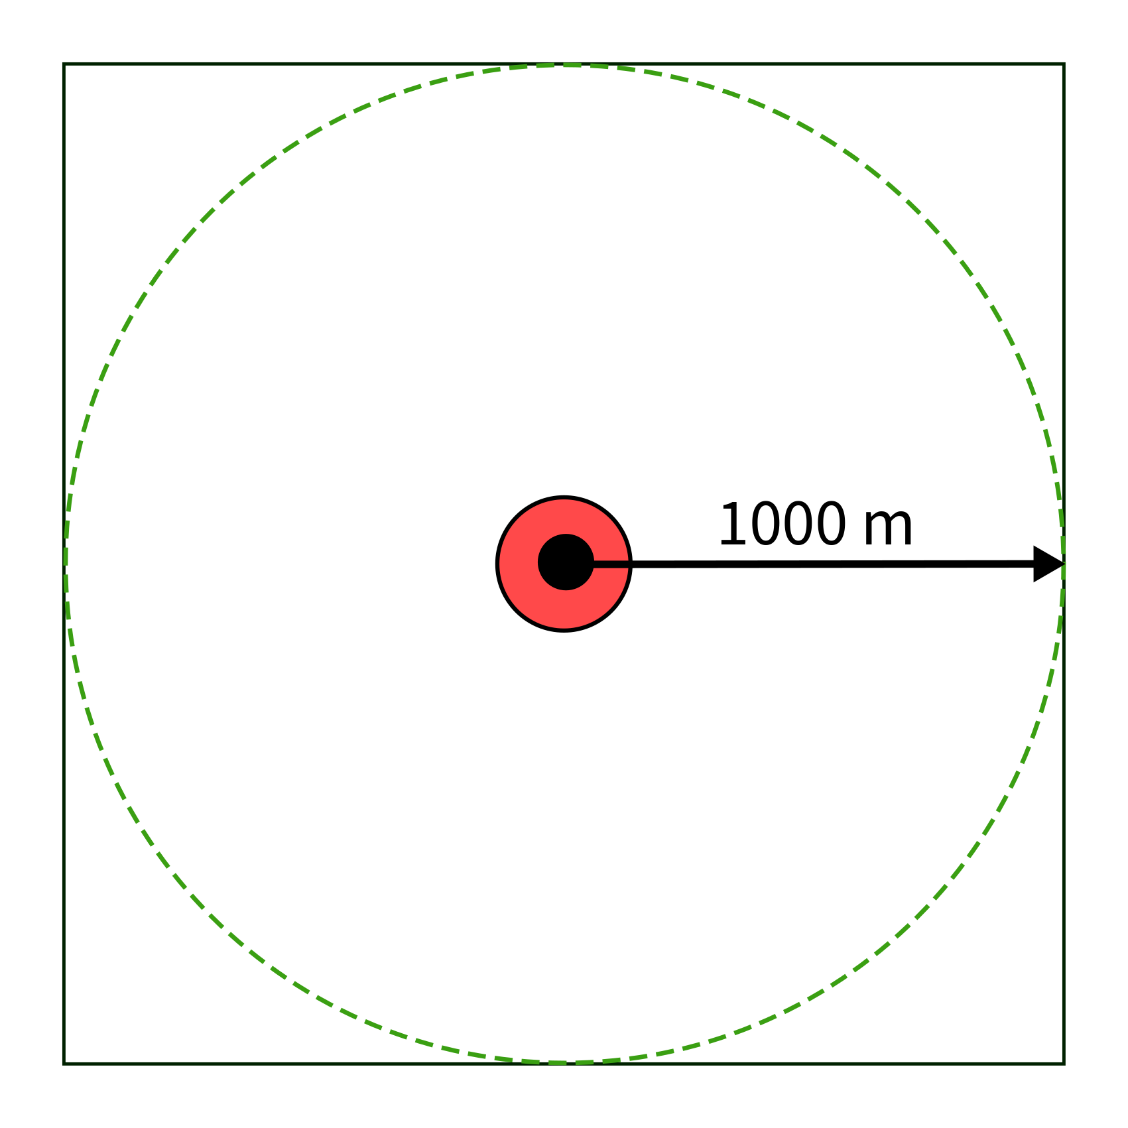
Data generation
Data generation
Clipping the raster by a buffer with the tell as the center: 52 samples, 73x73 px

Slide 7
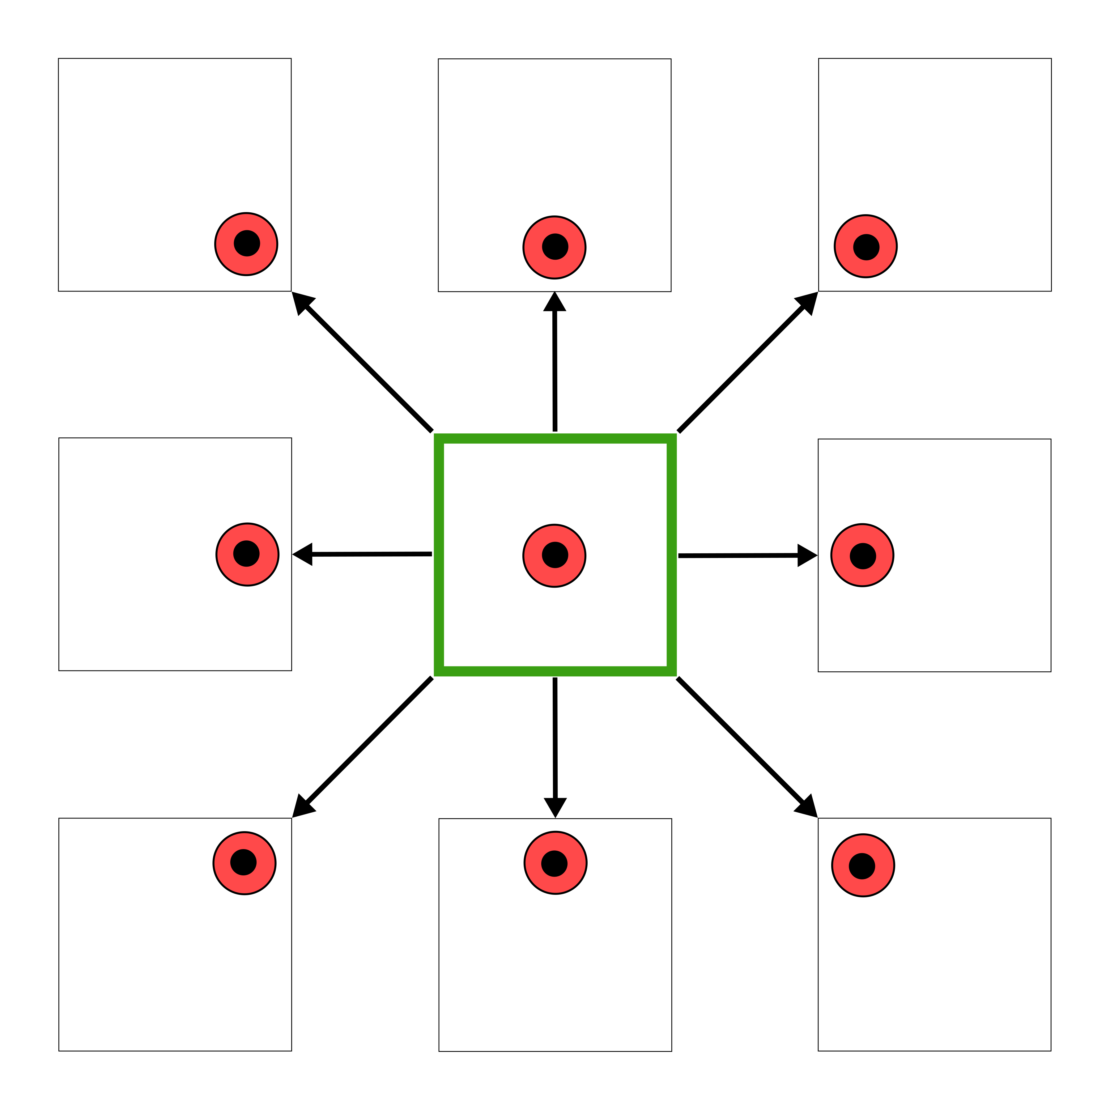
Data generation
Data generation
Clipping the raster by a buffer with the tell as the center: 52 samples, 73x73 px
19 sites were manually removed
Multiply the number of confirmed sites by shifting the georeferenced points around
→ 264 confirmed sites for the model

Slide 8
Data generation
Data generation
Clipping the raster by a buffer with the tell as the center: 52 samples, 73x73 px
19 sites were manually removed
Multiply the number of confirmed sites by shifting the georeferenced points around
→ 264 confirmed sites for the model

Slide 9
Data preparation
Generate and filter tiles
Tile the existing raster using GDAL in 73x73 px tiles
Filter nodata tiles
Find and remove tiles containing tells
Filter negative examples using a 900m buffer and remove them from all tiles

Slide 10
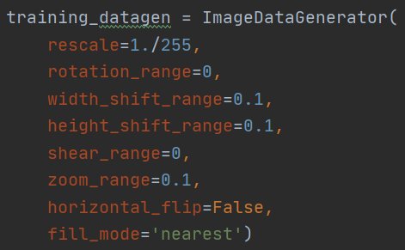
Data preparation
Data ratio 80:20 (422 training images; 106 validation images)
Augment data
No rotation, shearing, flipping
Minimal shifts, zooms

Slide 11
Results
Roadmap for detailed explanation of both models
1. Used Model
1.1 Model Summary
1.2 Used batch_size
1.3 Confusion Matrix
1.4 Model Plot
1.5 Solutions to Overfitting
2. Alternative Model
2.1 Alt. Model Summary
2.2 Alt. Used batch_size
2.3 Alt. Confusion Matrix
2.4 Alt. Model Plot

Slide 12
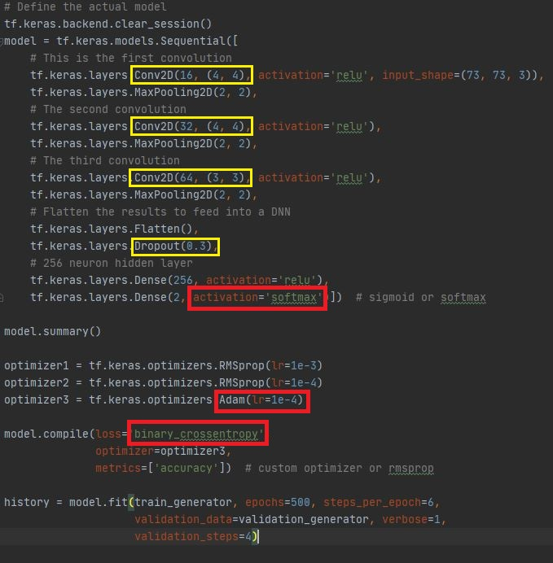
Used Model
3 x Conv2D-Layers
1 x Dropout-Layer (0.3)
1 x Dense-Layer (256 Neurons)
1 x Output-Dense-Layer (2 Neurons, Softmax)
Optimizer = Adam (learning rate = 0.0001)
Loss = binary_crossentropy
Epochs = 500

Slide 13
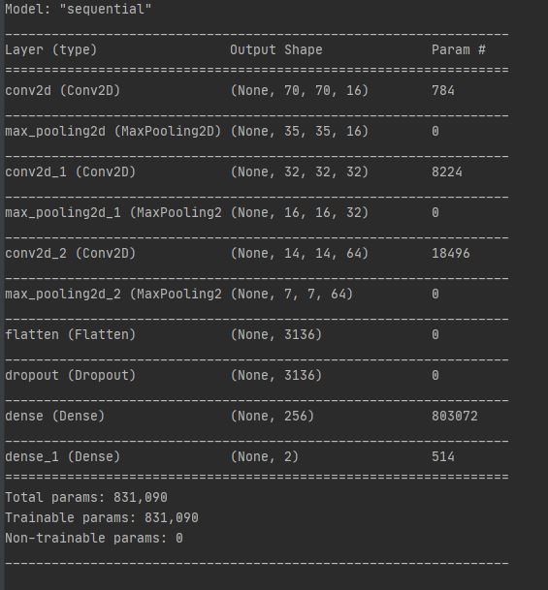
Model Summary

Slide 14
Used batch_size
Batch_Size used for training: 70 (* 6 = 420) for 422 images
Batch_Size used for validation: 27 (* 4 = 104 ) for 104 images
Match the product of batch_size * steps_per_epoch = images
Large batch_sizes seemed to work best for used model
Other models worked better with smaller batches

Slide 15
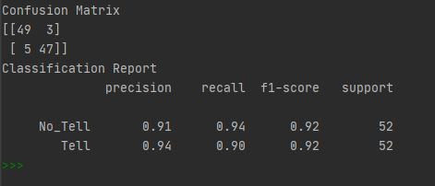
Confusion Matrix

Slide 16
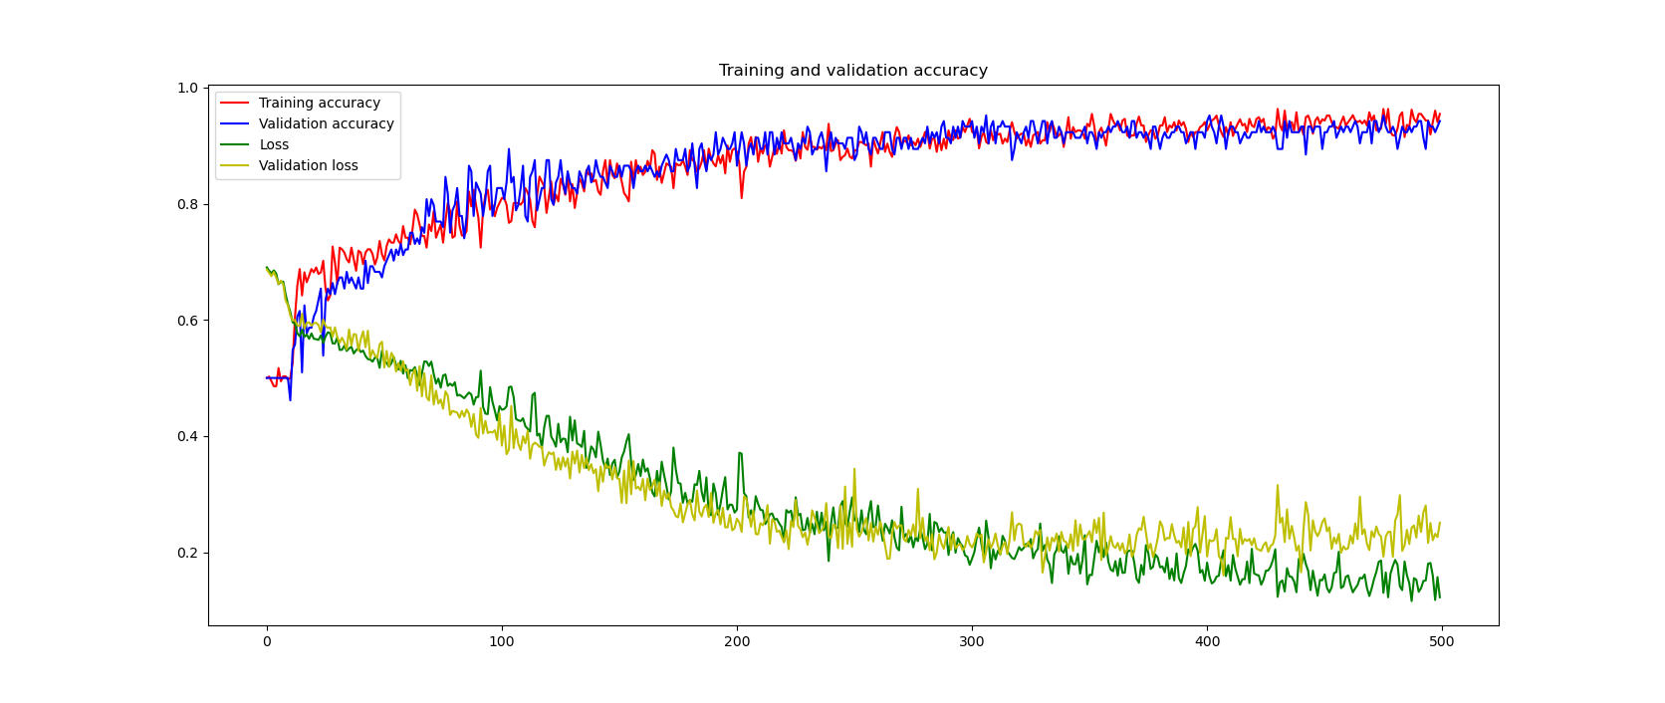
Model Plot

Slide 17
Model Plot
Acc > 95%
Val_acc > 95%
Loss > .2
Val_loss ~ .2
Problem:
Overfitting after certain threshold (around epoch 300)
General oscillation

Slide 18
Solutions to overfitting
What we couldn‘t try:
Increasing training data
What we tried:
Higher dropout (e.g. 0.5 instead of 0.3)
Less neurons/layers (e.g. 128 neurons instead of 256)
Lower learning rate (e.g. 1e-5 insead of 1e-4)
Lower learning rate in combination with smaller batch sizes

Slide 19
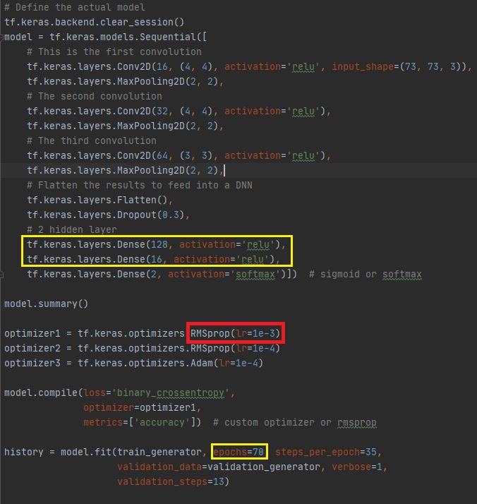
Alternative Model
3 x Conv2D-Layers
1 x Dropout-Layer (0.3)
2 x Dense-Layer (128 & 16 Neurons)
1 x Output-Dense-Layer (2 Neurons, Softmax)
Optimizer = RMSprop (learning rate = 0.001)
Loss = binary_crossentropy
Epochs = 70-100

Slide 20
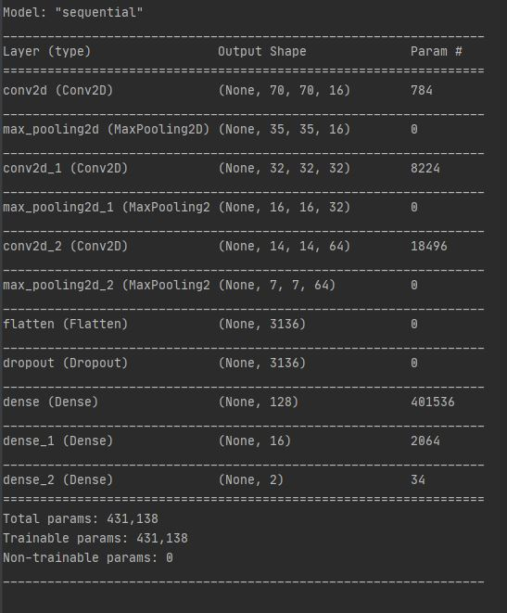
Alternative Model Summary
Half the parameters (430k) in comparison to the first model

Slide 21
Used batch_size for alt. model
Batch_Size used for training: 12 (* 35 = 420) for 422 images
Batch_Size used for validation: 8 (* 13 = 104 ) for 104 images
Match the product of batch_size * steps_per_epoch = images
Smaller batch_size than for the first model

Slide 22
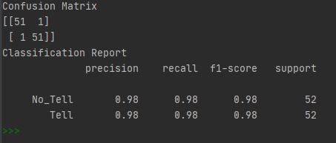
Confusion Matrix for alt. model

Slide 23
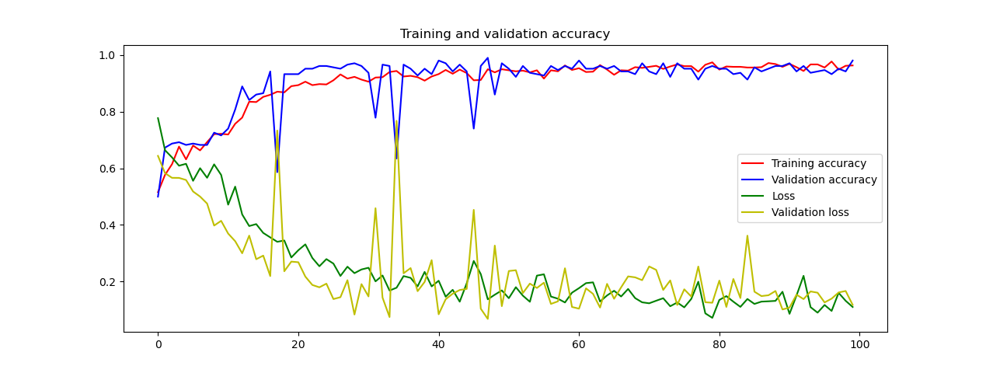
Alt. Model Plot
Acc > 97%
Val_acc > 97%
Loss > .2
Val_loss > .2
Problem:
Instability as seen in the random spikes
Randomness

Slide 24
Encountered Difficulties
Not enough positive samples of tells
Classic machine learning approach more suitable?
Make the model work correctly
Dips in Validation Accuracy & Loss
Too many interrelated dependent variables for fine tuning without proper knowledge
Overfitting

